Slide 1
Overview of Nucleon Spin Structure at Large x
3rd International Workshop on Nucleon Structure at Large x
Zein-Eddine Meziani
Temple University, Philadelphia
Outline:
Longitudinal Spin Structure
Quark helicity dependent distributions
Transverse Spin Structure
Transversity
Transverse momentum distributions and 3D imaging in -space
Partons Correlations
Quark-gluon correlations
Summary

Slide 2
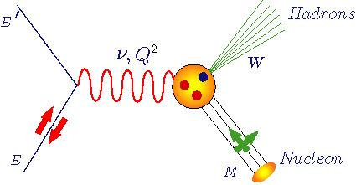
Inclusive DIS Structure Functions
Unpolarized structure functions F₁(x,Q²) and F₂(x,Q²)
Polarized structure functions
g₁(x,Q²) and g₂(x,Q²)
U
Q² :Four-momentum transfer
x : Bjorken variable
: Energy transfer
M : Nucleon mass
W : Final state hadrons mass
L
T

Slide 3
Longitudinal Spin Structure at Large x
Determine the valence up and d quark helicity dependent distributions to the highest possible x
Impact:
Test our understanding of the nucleon spin structure when the struck quark carries most of the nucleon momentum.
Ratios and can be predicted in pQCD and quark models
Construct higher moments of structure functions and connect with matrix element of quarks and gluon fields
test Lattice QCD

Slide 4
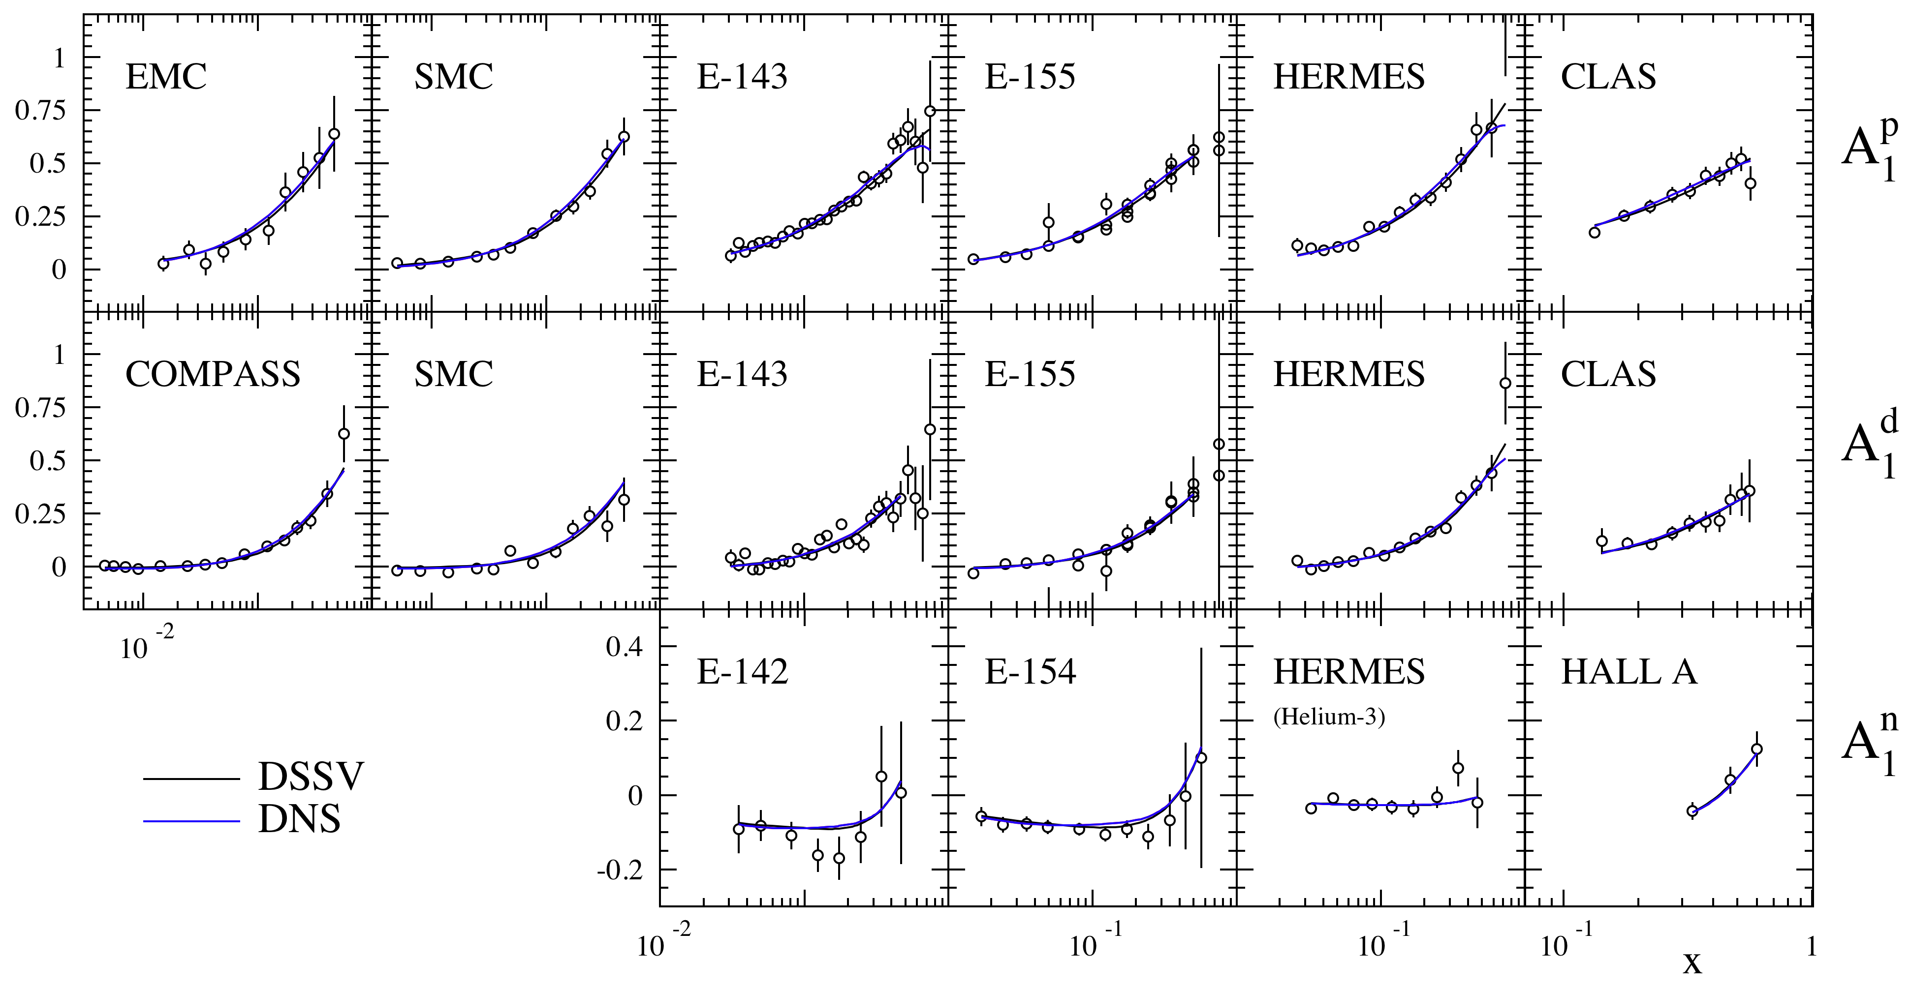
Inclusive Longitudinal Spin Asymmetries
D. De Florian et al. arXiv:0804.0422
20 years of polarized DIS (CERN, SLAC, DESY, JLab )

Slide 5
Quark helicity distributions
Results from inclusive and semi-inclusive DIS
Latest COMPASS results compatible with those of HERMES in the overlap region
JLab results dominate the high x region
Distributions are non zero and peaked in the valence region
All other distributions compatible with zero with slightly positive
Comparison with the DSSV-analysis which includes pp data gives a consistent picture.
COMPASS, 2010

Slide 6
Quark and Gluon helicity distributions
HERMES, arXiv:1002.3921
Small values of in measured region
Strong constraints from RHIC data
DIS and pp data seem consistent
Error on is still large
Global DSSV analysis (de Florian, Sassot, Stratmann, Vogelsang 2008/2009)

Slide 7
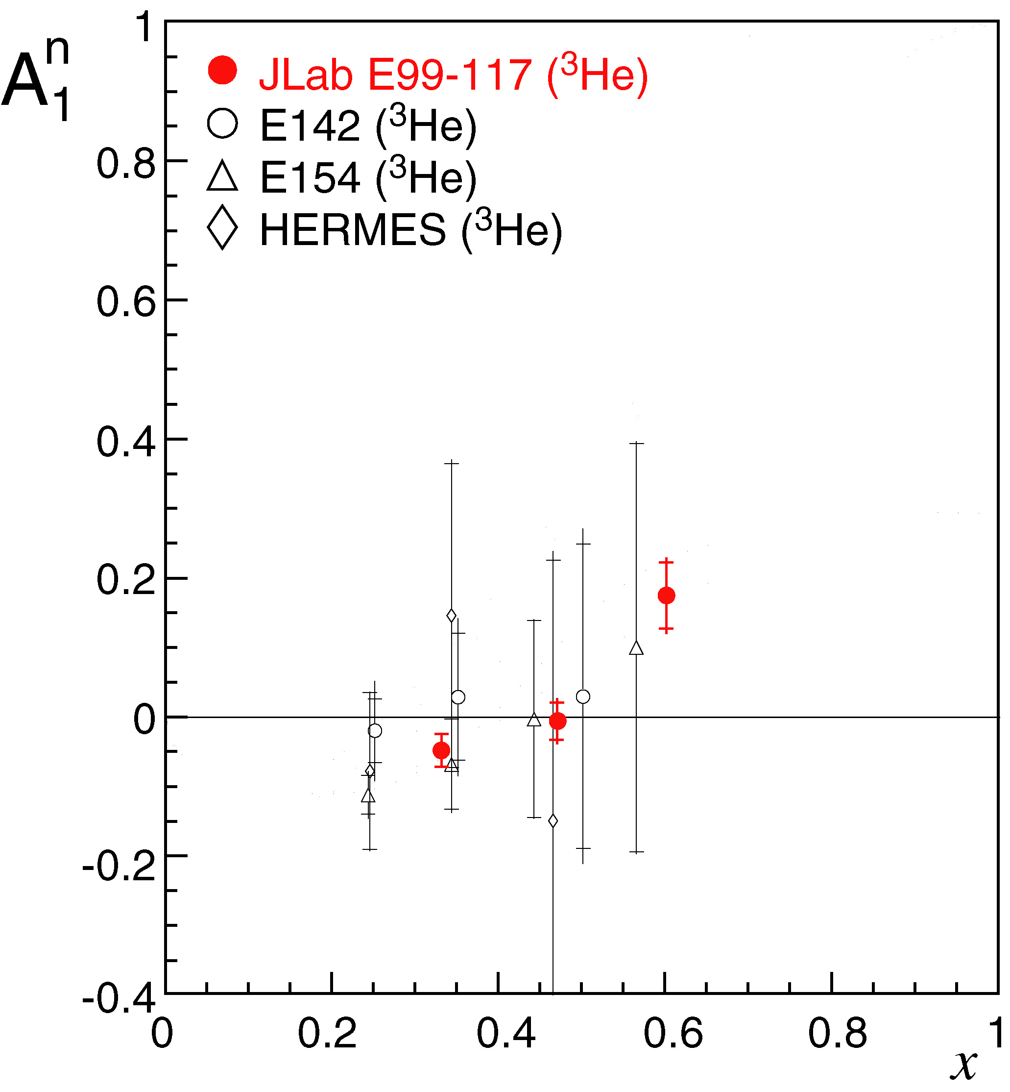
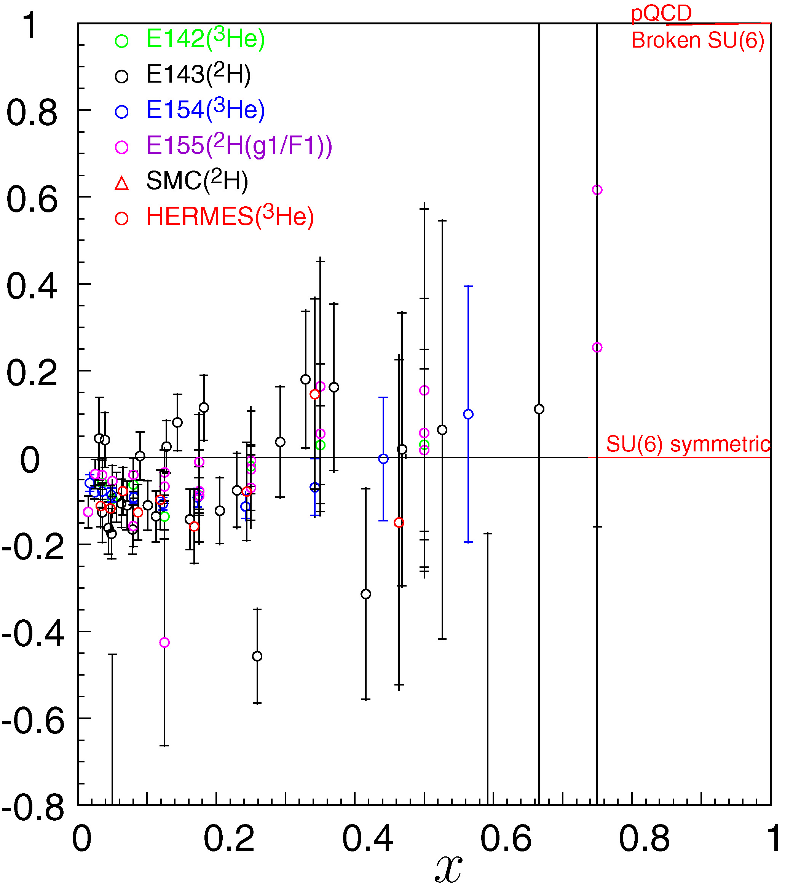
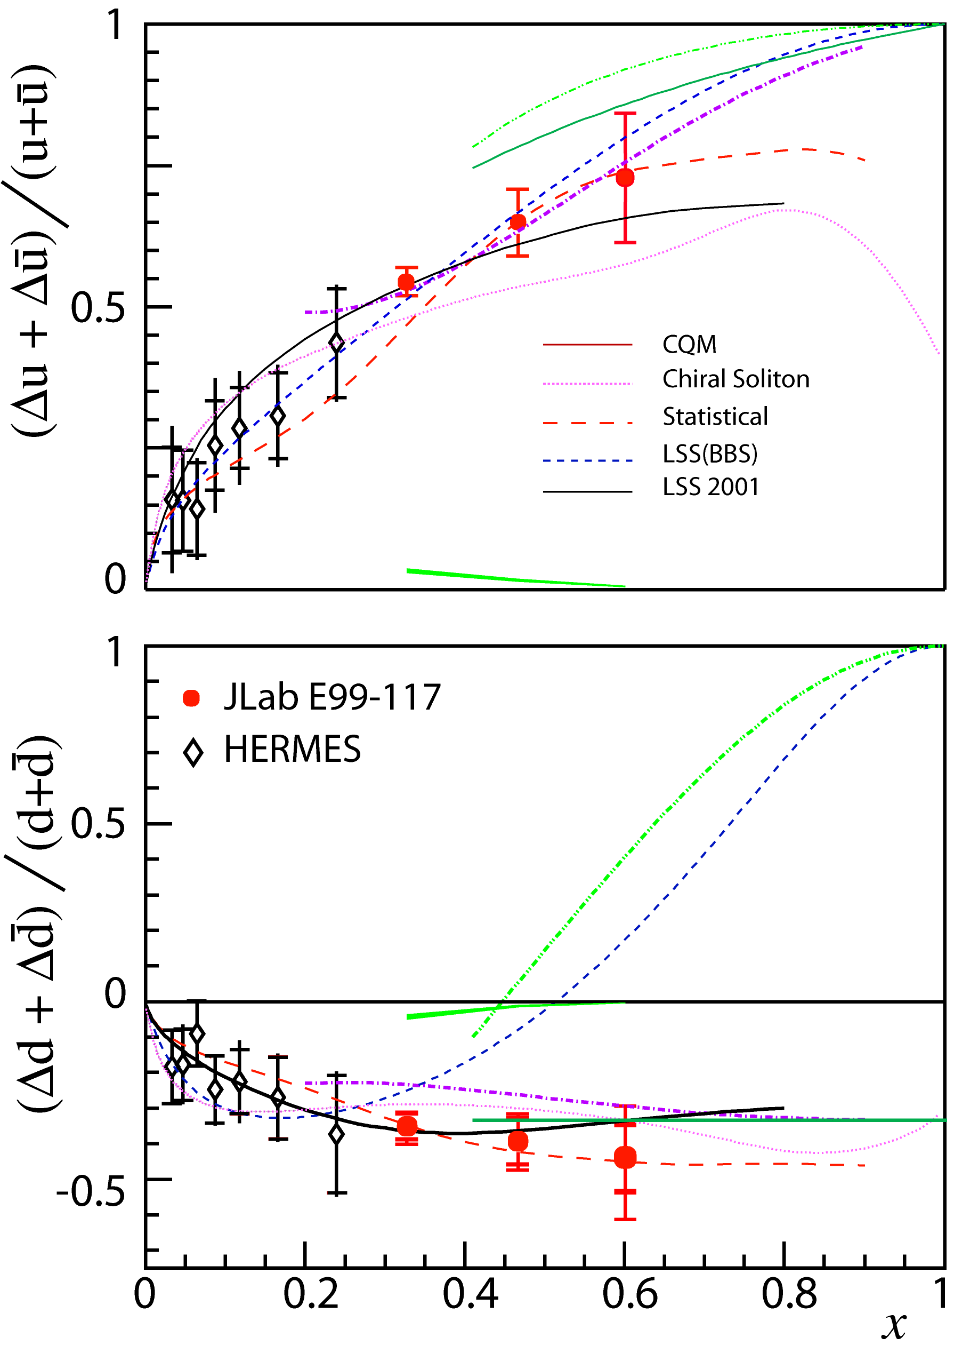
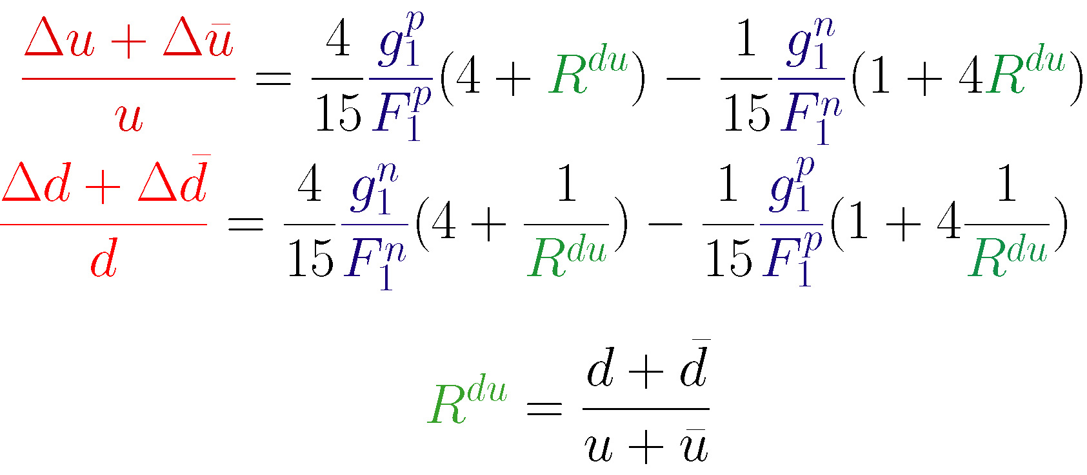
A₁^{n} and Helicity-Flavor Decomposition
JLab E99-117

Slide 8
HiX 2004 Workshop, Marseille, France
W. Vogelsang

Slide 9
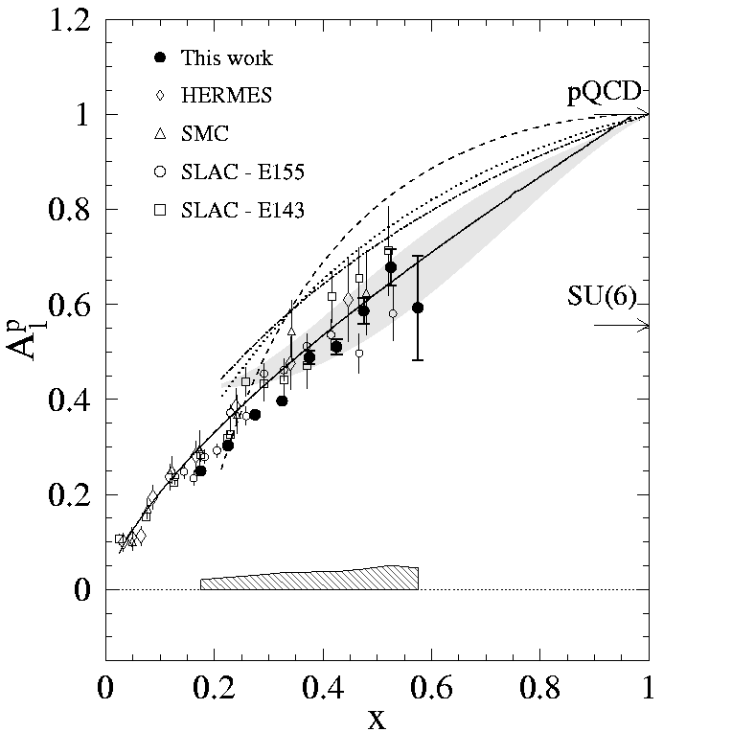
Virtual photon asymmetry A₁
Jlab/
Hall B
Duality
d
A_{1d} (D-state corrected)
Hyperfine perturbed QM
World data parameterized at Q²=10 GeV²
p
N. Isgur, Phys. Rev. D 59, 34013
F. Close and W. Melnitchouk, Phys. Rev. C 68, 035210

Slide 10
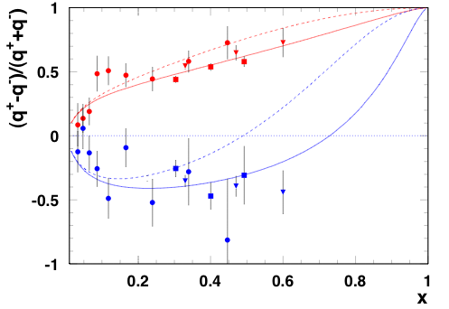
Effect of quark orbital angular momentum
Inclusive Hall A and B and Semi-Inclusive Hermes
BBS
BBS+OAM
Avakian, Brodsky, Deur and Yuan
Phys.Rev.Lett.99:082001,2007.

Slide 11
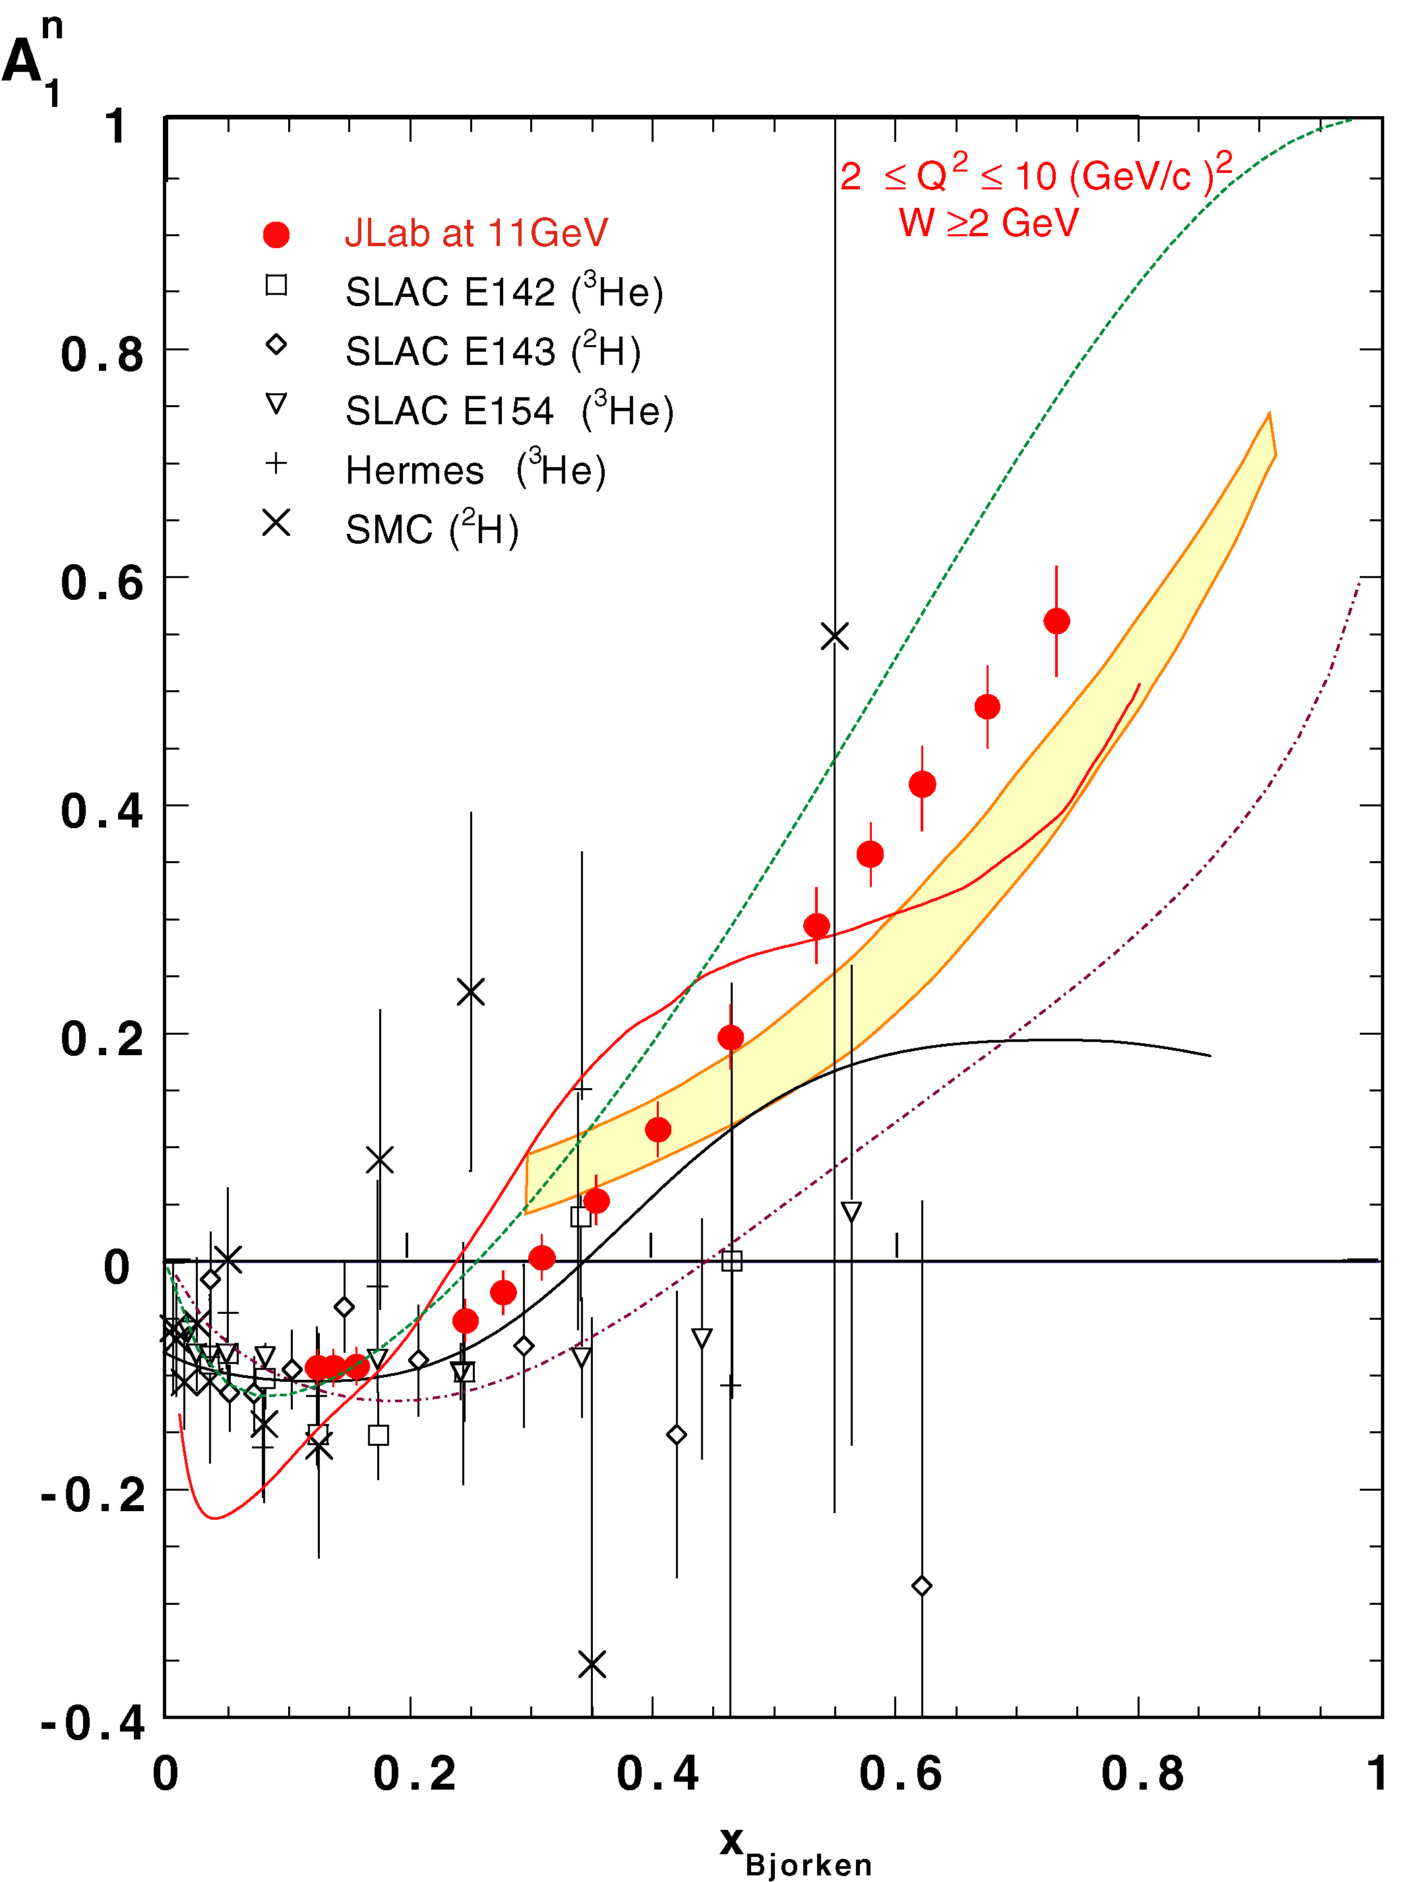
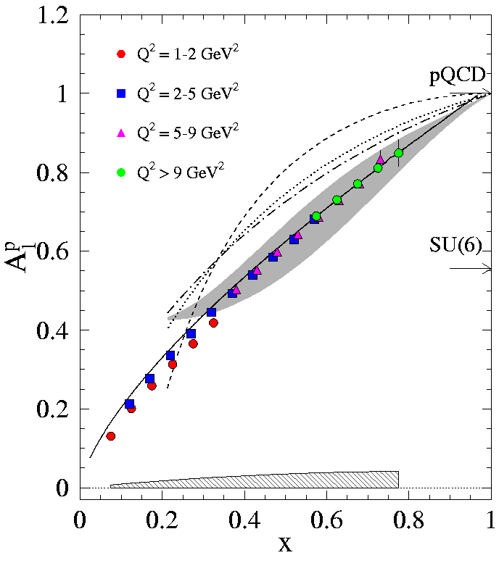
Asymmetries using the 12 GeV upgrade
A₁^{n} at 11 GeV Hall C
CLAS12
Proton
W>1.2

Slide 12
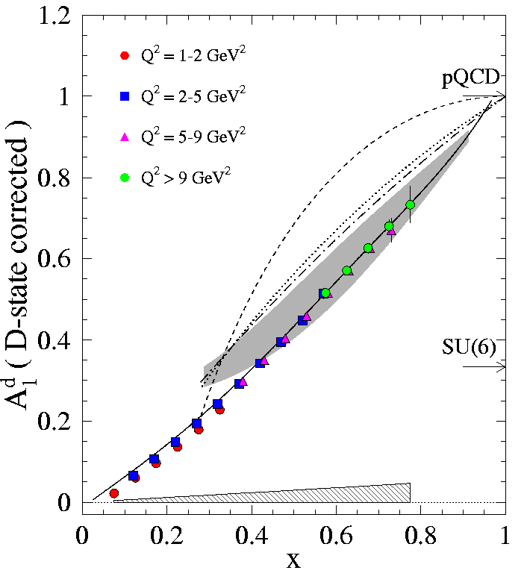
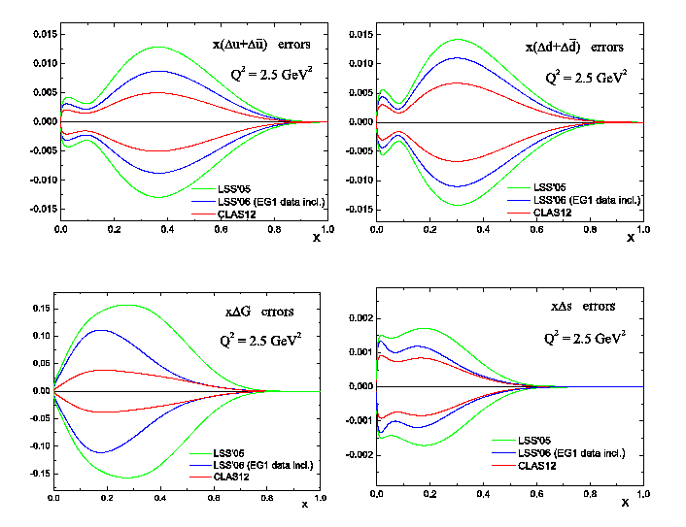
CLAS 12
Deuteron
Deuteron data impact the error
determination of Delta G significantly

Slide 13
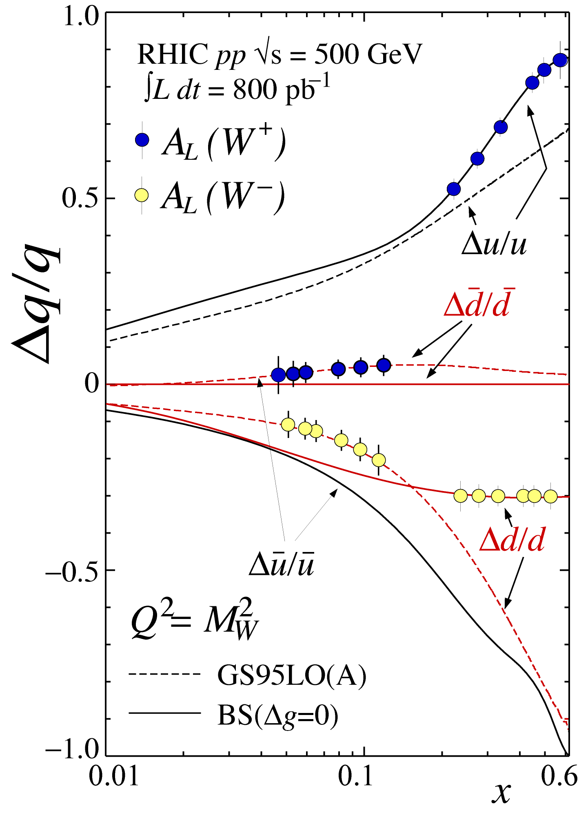
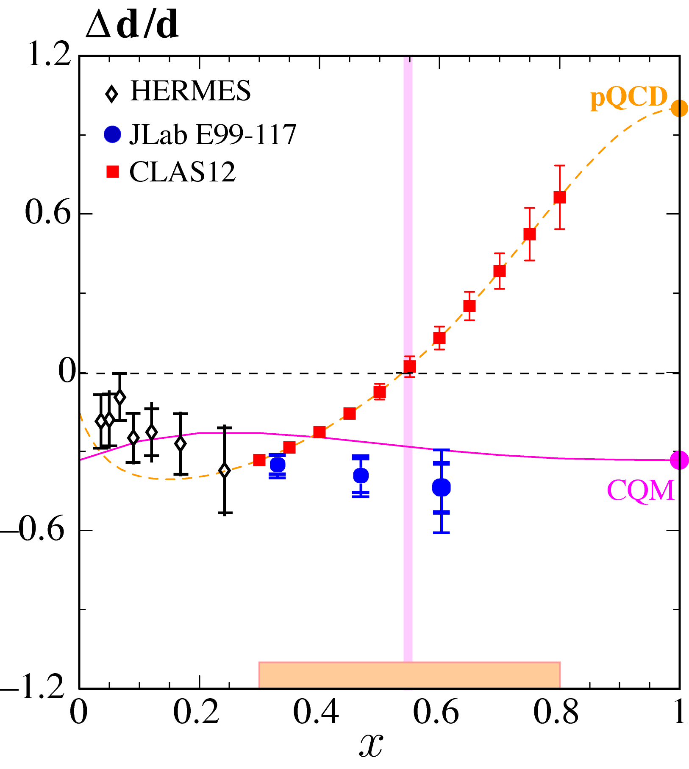
Flavor decomposition
At RHIC with W production
At JLab 12 GeV with SIDIS

Slide 14
First RHIC results from W production in pp collisions

Slide 15
Transverse Spin Structure: Leading Twist TMDs
Nucleon Spin
Quark Spin
Quark /Nucleon |  | Quark polarization
 |  | Un-Polarized | Longitudinally Polarized | Transversely Polarized
Nucleon Polarization | U
 | L
 | T
f₁ =
h₁⊥ =
Boer-Mulder
g₁ =
h_{1L}⊥ =
Helicity
h_{1T} =
f _{1T}⊥ =
Transversity
g_{1T} ⊥ =
Sivers
h_{1T}⊥ =
Pretzelosity
Notes:
Beside the three parton distribution functions which survive the integration over the quark transverse momentum there are five more transverse momentum dependent distribution functions at leading twist.
Here is a table of all the 8 leading twist TMDs, the cartoons on the right hand side of each name tell you the meaning of each TMDs. Again, the virtual photon is supposed to go out of the paper and that’s our longitudinal direction. The red circle and arrow are the quark and it’s spin, and black circle and arrow are the nucleon and it’s spin. The blue arrow shows the momentum direction of the quark.
An important information these 5 new TMDs will tell you is the quark oribtal angular motion. They will vanish without orbital angular momentum.
In particular, the Sivers function directly tells you the quark orbital angular momentum in a transverse polarized target, Boer-Mulder tells you the correlation of the quark orbital momentum and it’s spin inside a unpolarized nucleon and Pretzelosity, in certain model context, direct measures the relativistic nature of the nucleon.
Blue: no kt dependence and T-even
Red: T-odd with kt dependence
Other: kt dependence and T-even

Slide 16
Transversity distribution
Quark transverse polarization in a transversely polarized nucleon:
Can be probed in Semi-Inclusive DIS, Drell-Yan processes.
Does not mix with gluons, has valence like behavior.
Nucleon tensor charge can be extracted from the lowest moment of h₁ and compared to LQCD calculation:
h_{1T} =
Nucleon Spin
Quark Spin

Slide 17
Transversity using COMPASS and HERMES SIDIS data and the Belle data
A good start, good agreement with models
Soffer bound imposed in the extraction
What happens if it is not imposed. Is the Soffer bound violated?
Soft gluon emission should reduce the extracted quantity by a factor of 2 ?! (Boer, 2008)
Anselmino et al. 2008
Notes:
Exploiting the transverse momentum dependence of the Collis effect one can extract transversity.

Slide 18
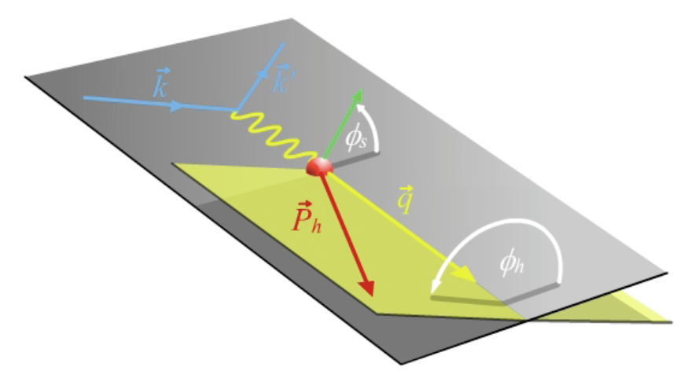
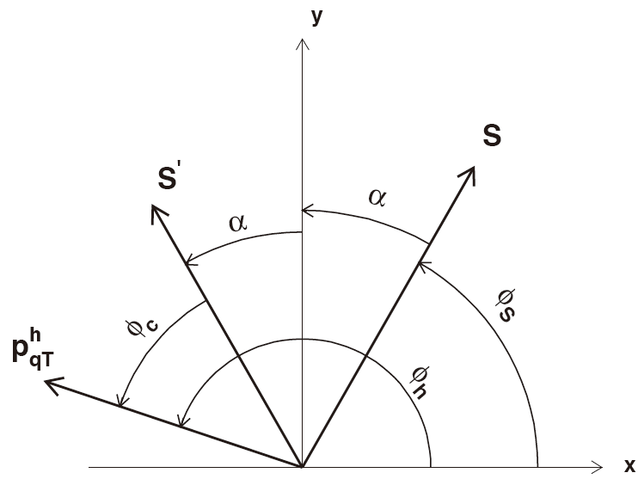
SIDIS electroproduction of pions
With spin one can separate Sivers and Collins effetcs
Sivers angle, effect in distribution function:
(ϕ_{h}-ϕ_{s}) = angle of hadron relative to initial quark spin
Collins angle, effect in fragmentation function:
(ϕ_{h}+ϕ_{s}) = π+(ϕ_{h}-ϕ_{s’}) = angle of hadron relative to final quark spin
target angle
hadron angle
Scattering Plane
q
e-e’ plane

Slide 19
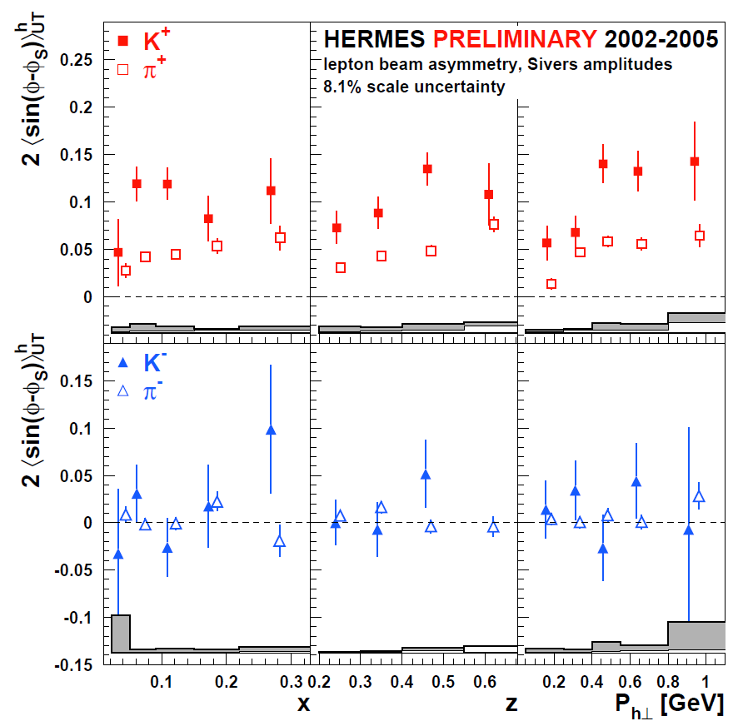
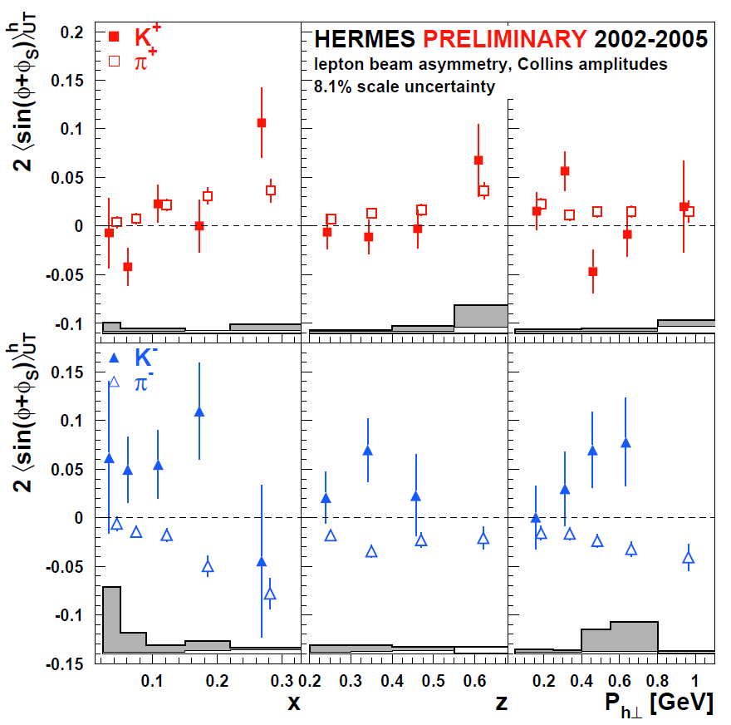
HERMES Hydrogen Results (2002-2005)
Sivers Moment
Collins Moment
0.1 0.4 0.6 0.5 1
X z P_{t}[GeV]
arXiv:0906.3918
arXiv:0706.2242

Slide 20
3-D structure of the nucleon: Dipole partern due to Sivers effect
( Plot from Prokudin; red positive effect, blue:negative effect)
Notes:
Model dependent, plot generated from data.

Slide 21
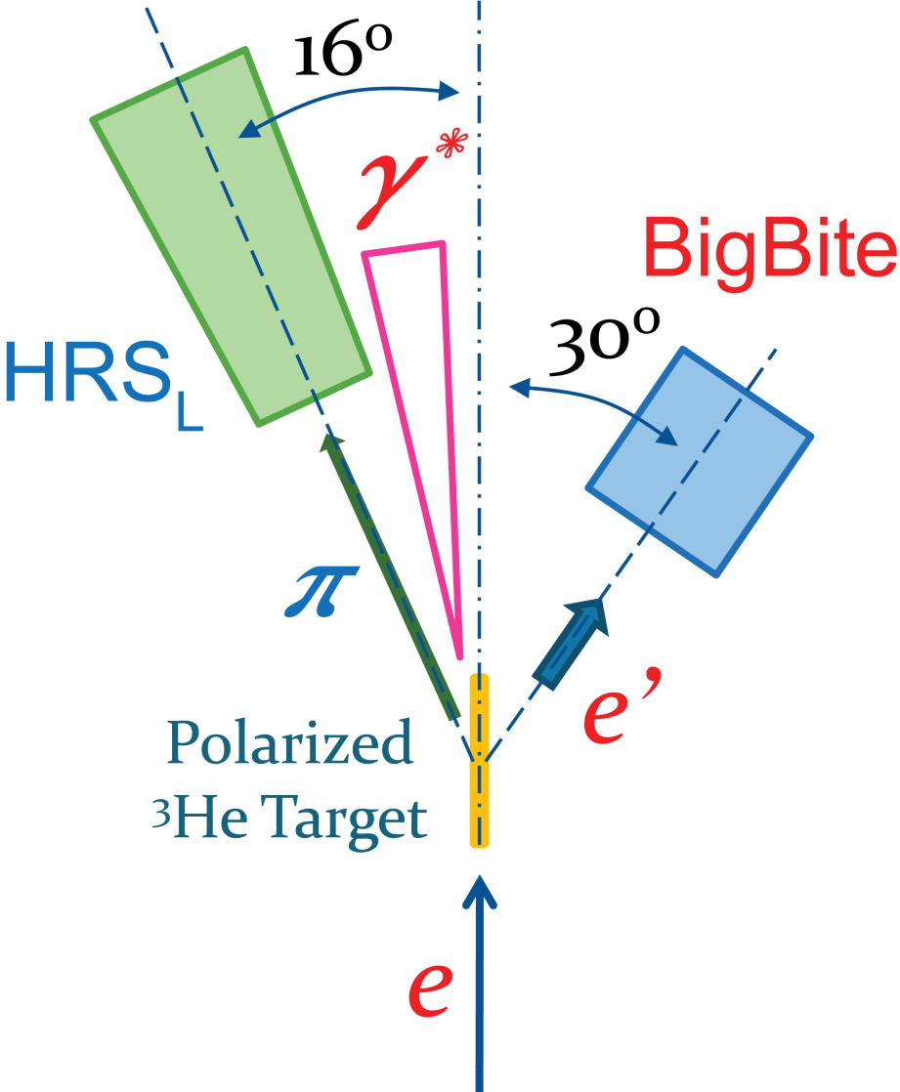
E06‑010 Experiment to access the neutron
Spokespeople: X. Jiang (Los Alamos), J.-P. Chen (JLab), H. Gao (Duke), J.C. Peng (UIUC),
Students:Xin Qian (Duke), Chiranjib Dutta (Kentucky), and Kalyan Allada (Kentucky)
Luminosity
Monitor
Polarized ³He Target
Polarized Electron Beam
~80% Polarization
Fast Flipping at 30Hz
PPM level charge Asymmetry controlled by online feed back
BigBite at 30º as Electron Arm
P_{e} = 0.7 ~ 2.2 GeV/c
HRS_{L} at 16º as Hadron Arm
P_{h} = 2.35 GeV/c
Beam Polarimetry
(Møller + Compton)
Notes:
What’s new:
Neutron Target
Helicity Flip -> Cancel drift/cancel false asym.
Beam charge feed back -> PPM level Charge Asym

Slide 22
See Xiaodong Jiang’s talk

Slide 23
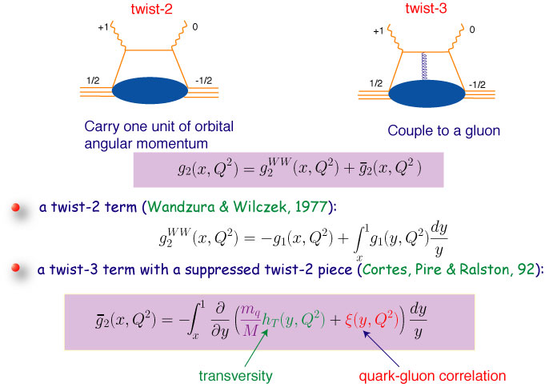
Quark Gluon Correlations

Slide 24
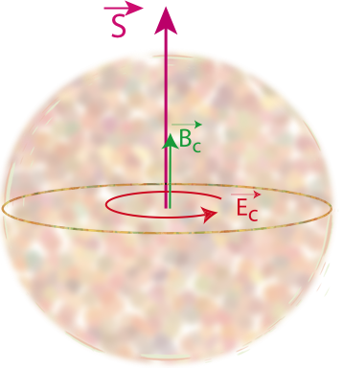
“Color Polarizabilities”
X.Ji 95, E. Stein et al. 95

Slide 25
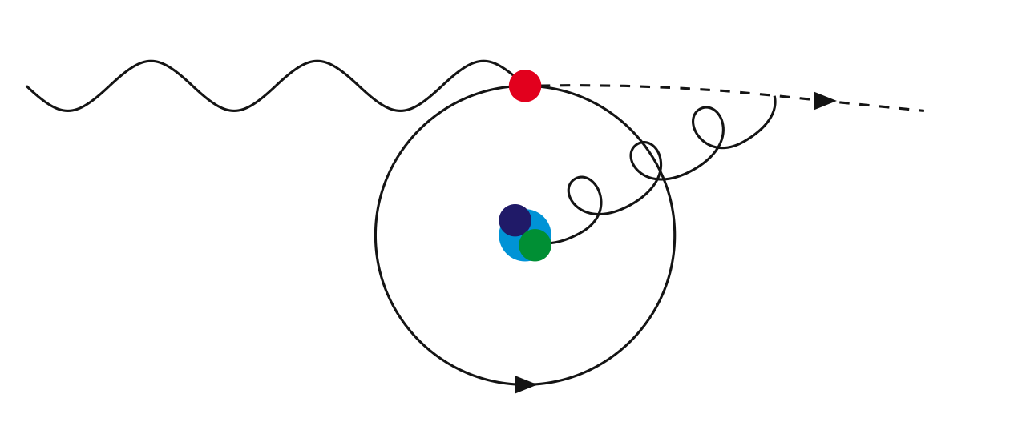
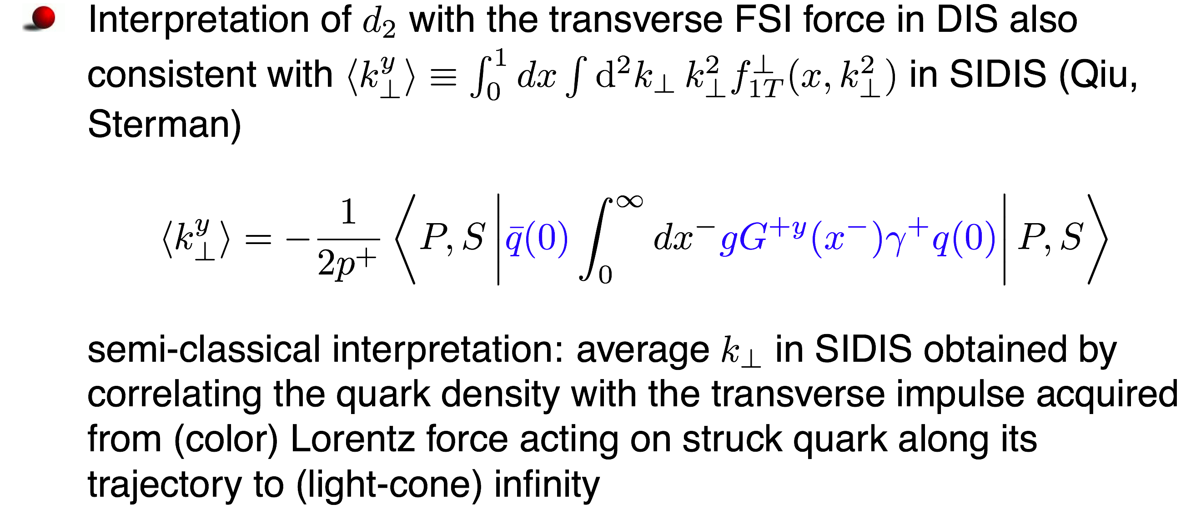
Average Color Lorentz Force (M. Burkardt)

Slide 26
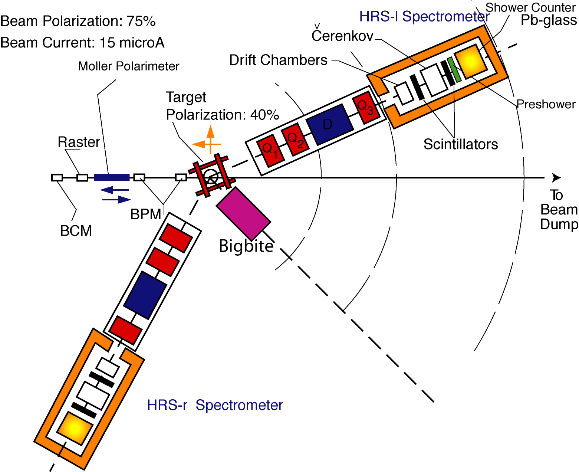
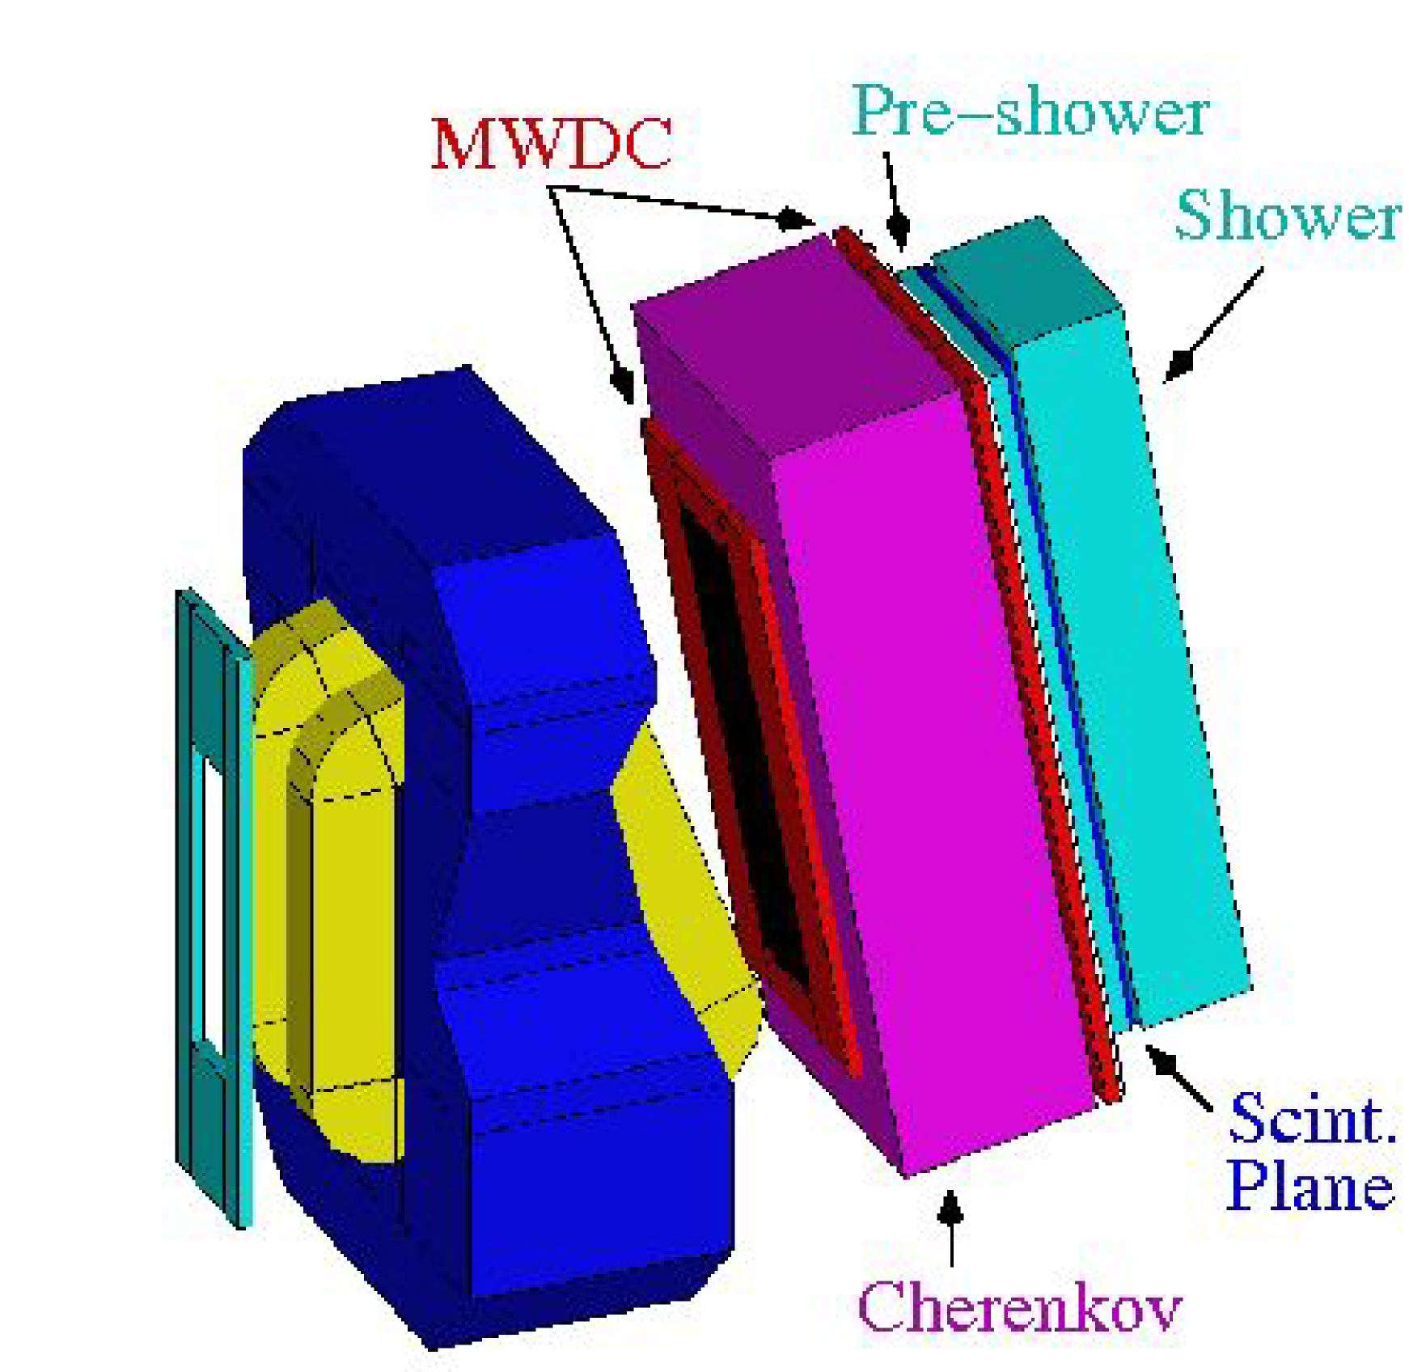
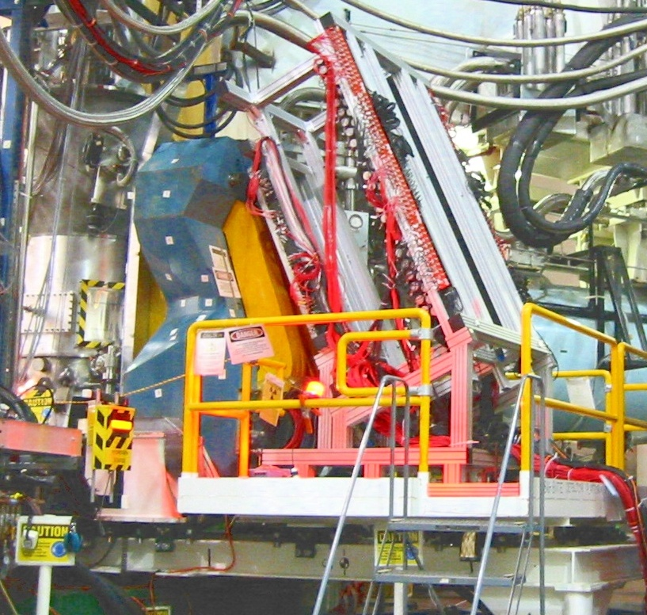
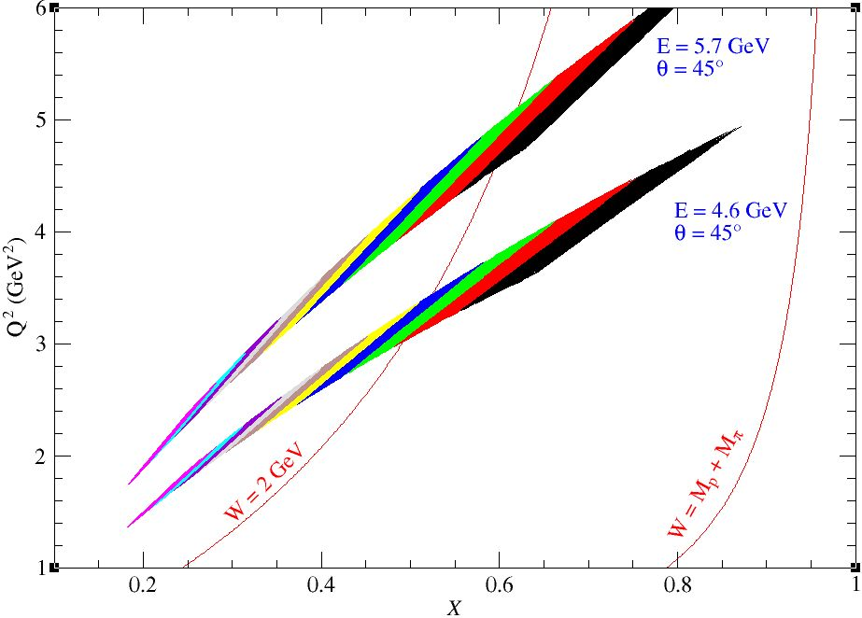
Experiment E06-114 (d₂^{n}) in Hall A
Two beam energies 4.6 and 5.7 GeV
(4 pass, 5 pass)
BigBite fixed at single scattering angle (θ=45°)
(data divided into 10 bins during analysis)
Experiment ran Jan.-Mar. 09

Slide 27
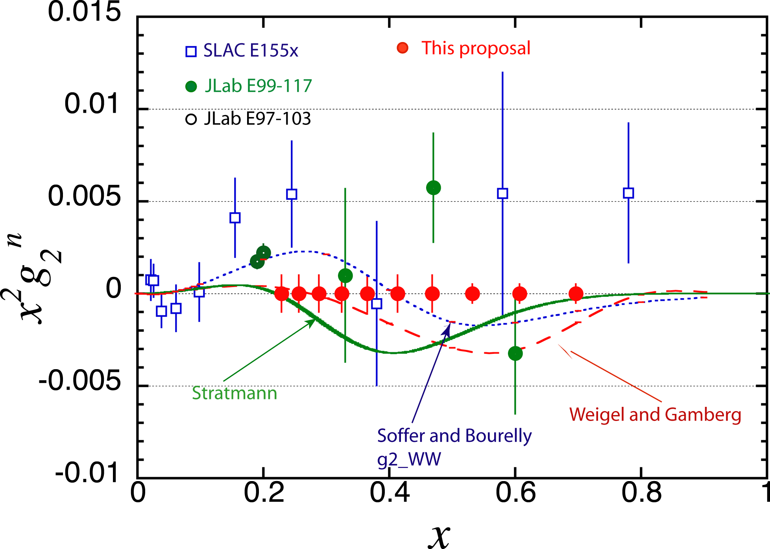
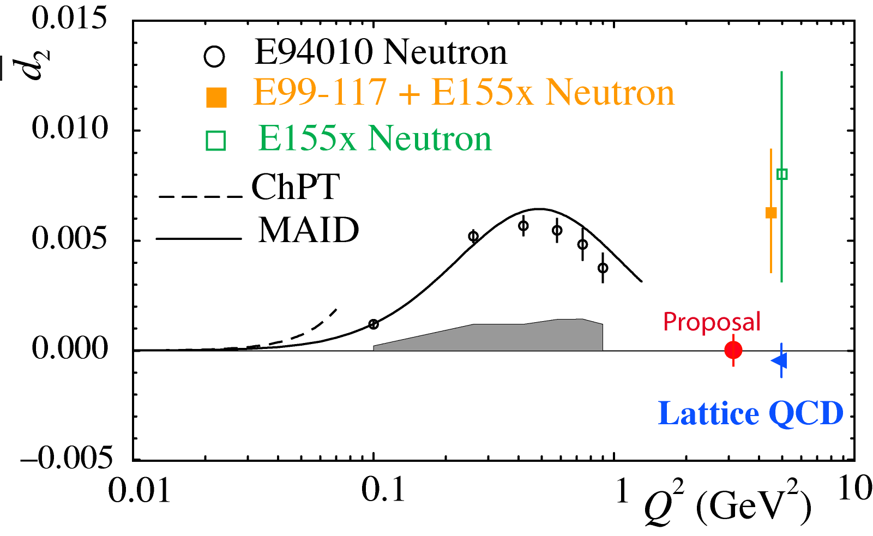
Expected precision in Experiment E06-114
At large Q², d₂ coincides with the reduced twist-3 matrix element of gluon and quark operators
At low Q², d₂ is related to the spin polarizabilities
Spokespeople:
B. Sawatzky, S. Choi, X. Jiang and Z.-E.M
Students:
David Flay, Diana Parno, Matthew Posik
and the Hall A collaboration

Slide 28
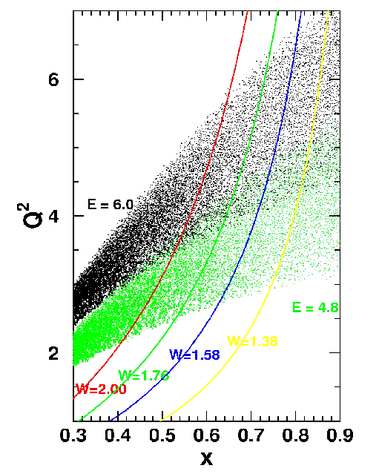
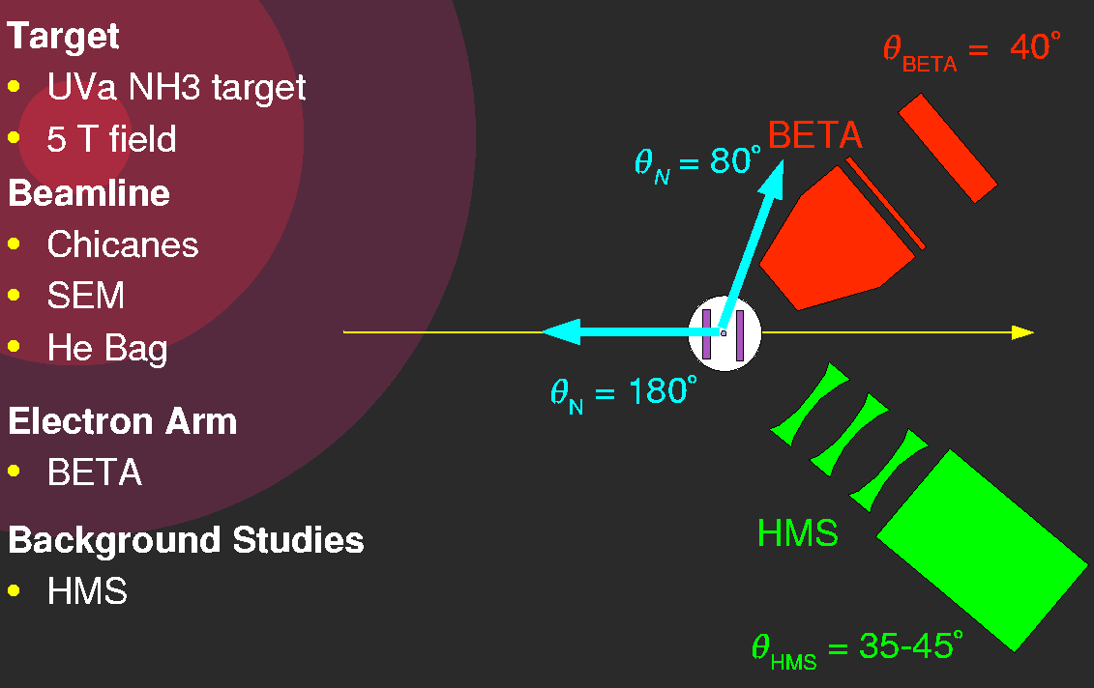
SANE Kinematics and Layout
SANE experiment in Hall C
Hall C
CEBAF polarized beam
85 nA
75% beam polarization
Two beam energies:
6.0 GeV (black)
4.8 GeV (green)
Experiment Ran January-March 09

Slide 29
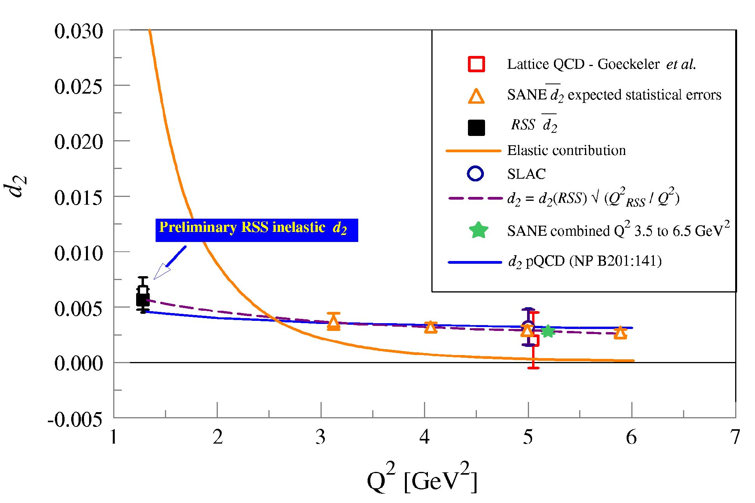
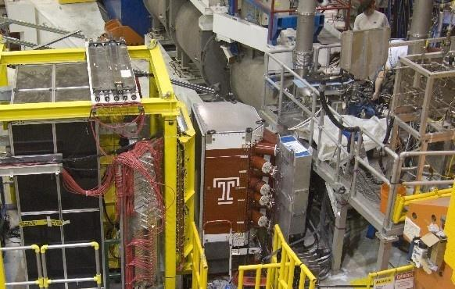
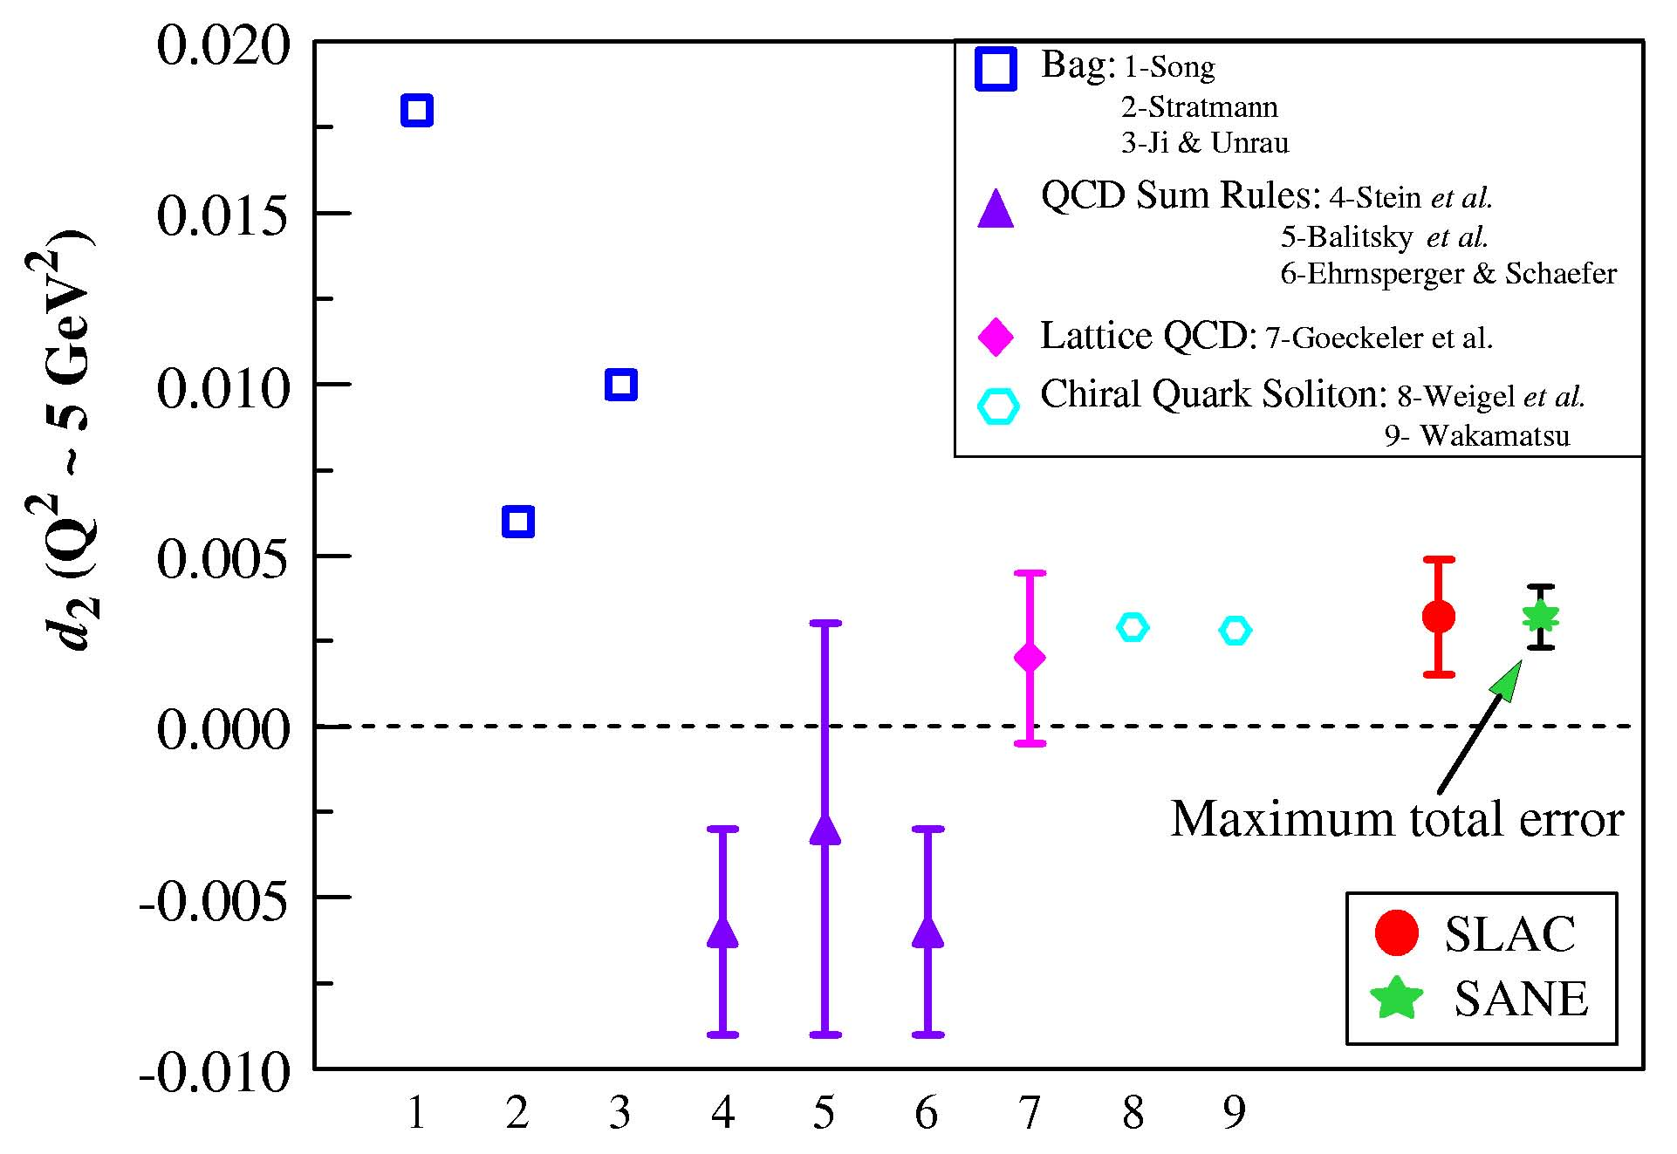
SANE d₂^{p} projection in Hall C
Spokespeople:
O. Rondon, S. Choi, M. Jones,, Z.-E. M
Students:
Whitney Armstrong, Hoo Kang, Aneesha Liyanage,
James Maxwell, Jonathan Mulholland
and the Hall C collaboration

Slide 30
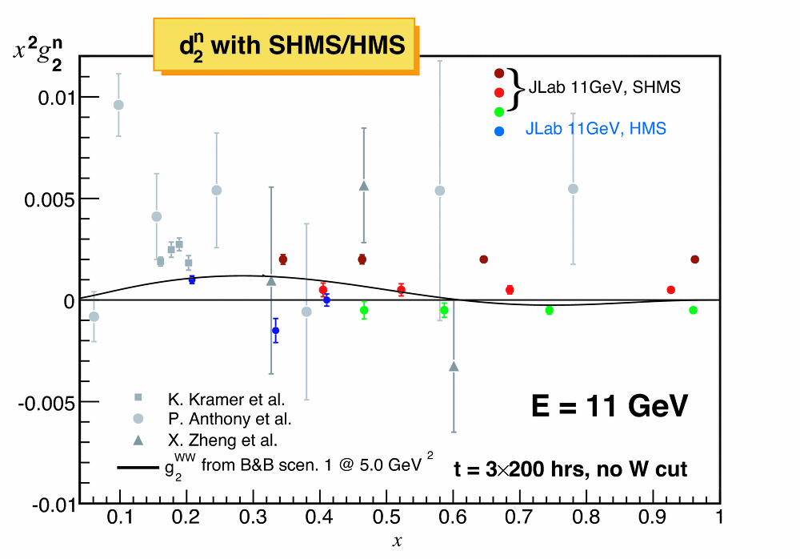
Projected x²g₂(x,Q²) results for Hall C
Projected points are vertically offset from zero along lines that reflect different (roughly) constant Q² values from 2.5—6 GeV².
g₂ for ³He is extracted directly from L and T spin-dependent cross sections measured within the same experiment.
Strength of SHMS/HMS: nearly constant Q² (but less coverage for x < 0.3)

Slide 31
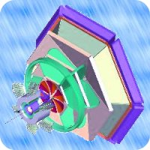
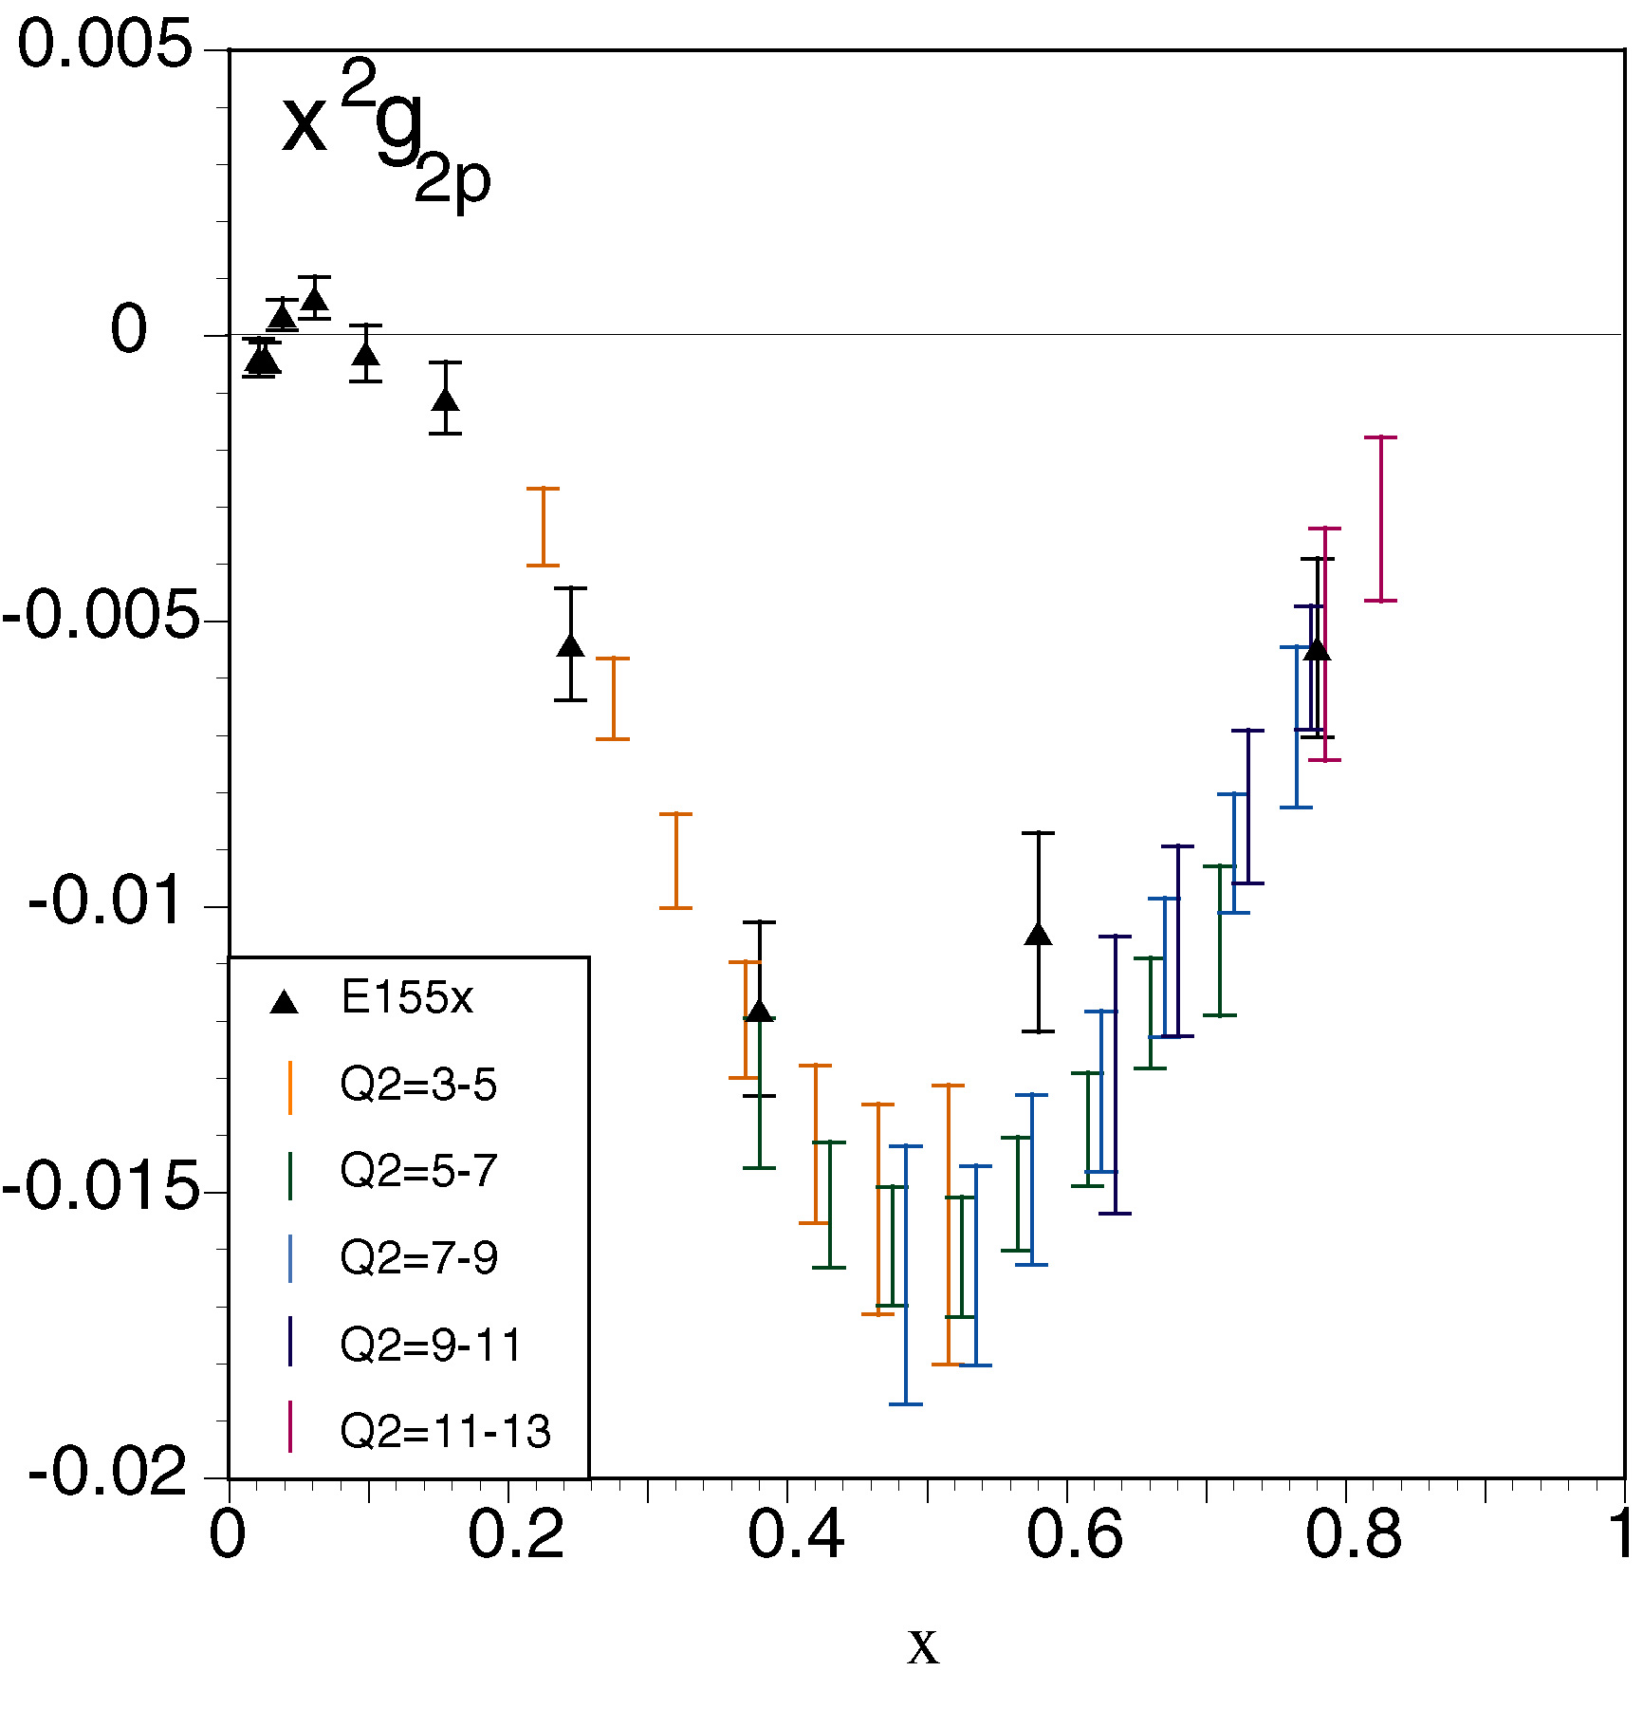
g₂ in CLAS 12 Hall B

Slide 32
Summary
An impressive set of data from HERMES, COMPASS, RHIC and JLab.
But at large x:
Higher x DIS data in the longitudinal structure of the nucleon are highly desirable
Test nucleon models, our undestanding of pQCD in action and the universality of extracted parton distributions.
Precision data at intermediate and higher x are needed to fully exploit the transverse structure of the nucleon in the valence region.
Tensor charge needs to be determined
Soffer bound needs to be verified at large x
Sign reversal of the Sivers function between Drell-Yan and SIDIS is to be checked
Sudakov effect need to be clarified
3-D picture in (x, k_{T}) using TMDs is still precision data hungry
Color force and color lensing will be extracted from the data.

